Slide 1
Un vistazo a las estadístisticas de la Iglesia en México y sus implicaciones para el futuro
(2000-2020)

Slide 2
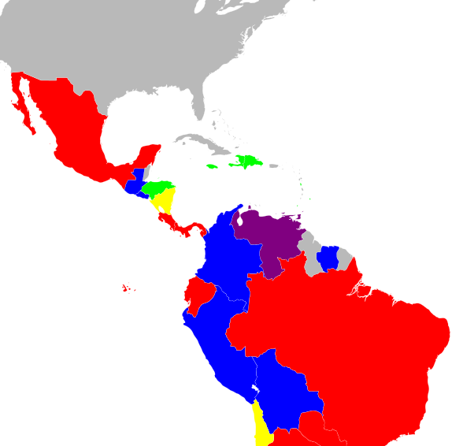
Territorio División Interamericana
This Photo by Unknown Author is licensed under CC BY-SA

Slide 3
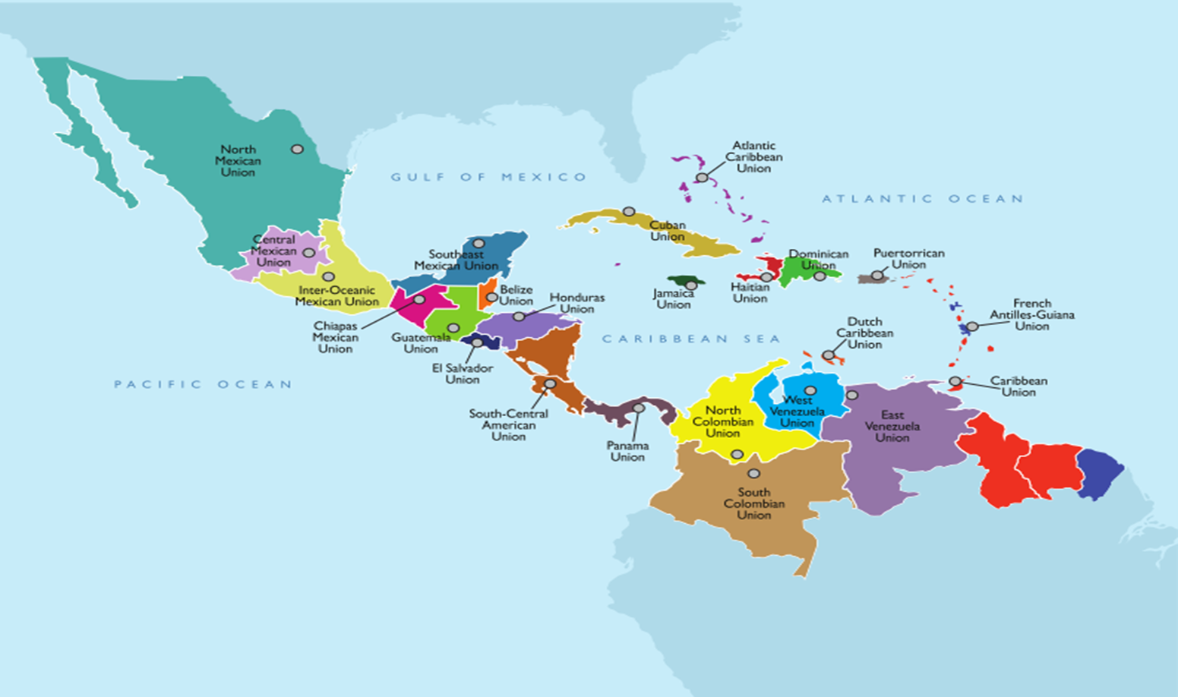

Slide 4
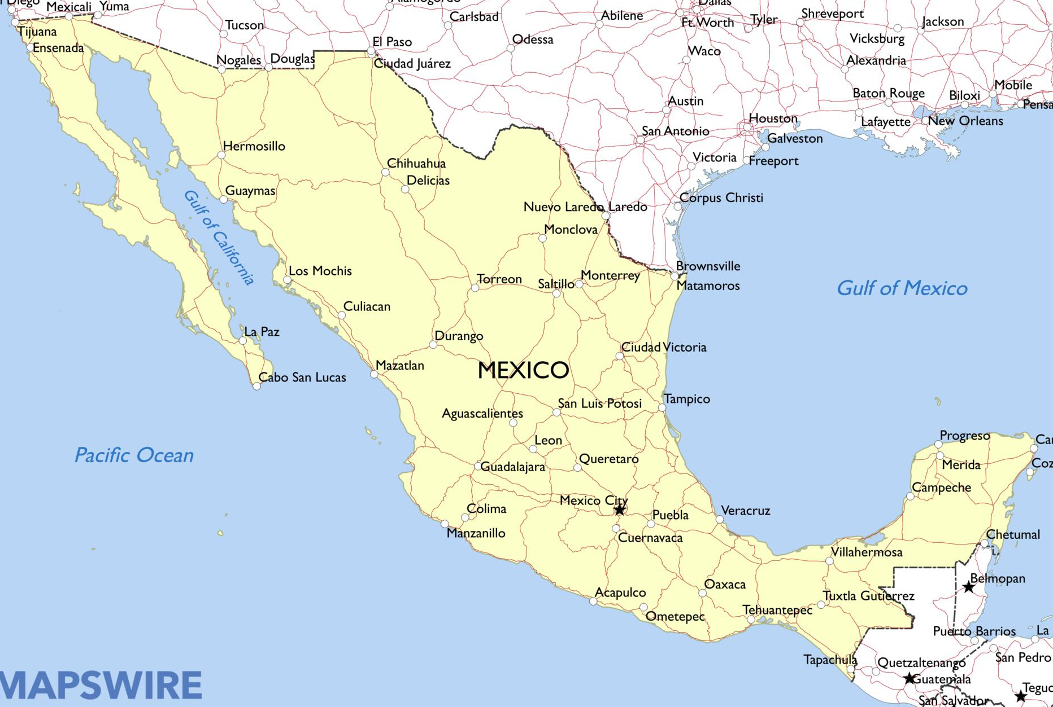
North Mexican Union 1985
Central Mexican Union 2008
South-east Mexican Union 2012
Inter-Oceanic Mexican Union 2001
Chiapas Mexican Union 2014
This Photo by Unknown Author is licensed under CC BY

Slide 5
North Mexican Union
Central Mexican Union
South-east Mexican Union
Inter-Oceanic Mexican Union
Chiapas Mexican Union
This Photo by Unknown Author is licensed under CC BY

Slide 6
North Mexican Union
Central Mexican Union
South-east Mexican Union
Inter-Oceanic Mexican Union
Chiapas Mexican Union
This Photo by Unknown Author is licensed under CC BY

Slide 7
North Mexican Union
Central Mexican Union
South-east Mexican Union
Inter-Oceanic Mexican Union
Chiapas Mexican Union
This Photo by Unknown Author is licensed under CC BY

Slide 8
North Mexican Union
Central Mexican Union
South-east Mexican Union
Inter-Oceanic Mexican Union
Chiapas Mexican Union
This Photo by Unknown Author is licensed under CC BY

Slide 9
North Mexican Union
Central Mexican Union
South-east Mexican Union
Inter-Oceanic Mexican Union
Chiapas Mexican Union
This Photo by Unknown Author is licensed under CC BY

Slide 10
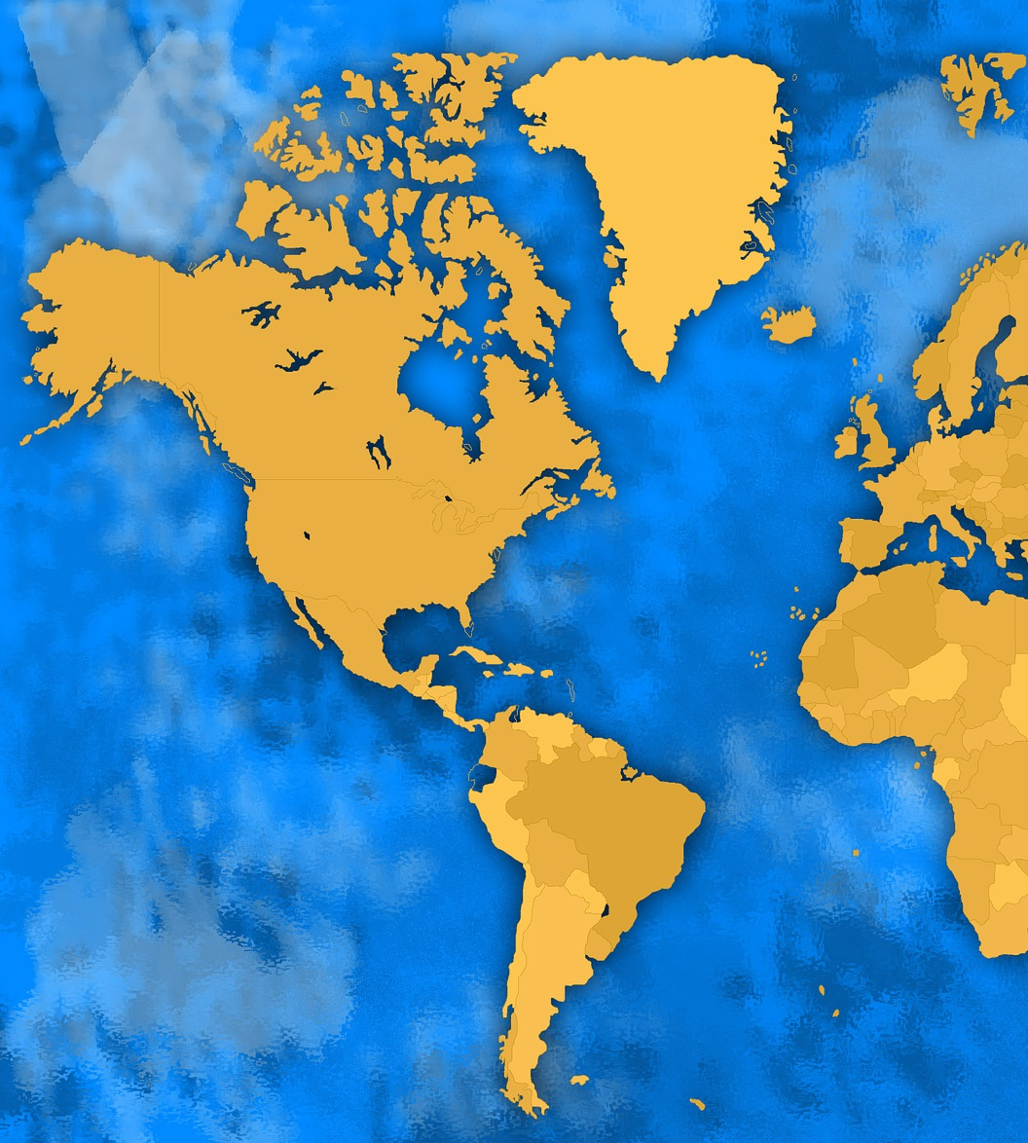
  Distribución de la Membresía
MÉXICO
CARIBE
CENTRO Y NORTE DE SUR AMÉRICA
801,622
22.0%
1,1230,187
34.0%
1,629,477
44.0%
Notes:
It would appear that God holds the shepherds accountable for the sheep

Slide 11

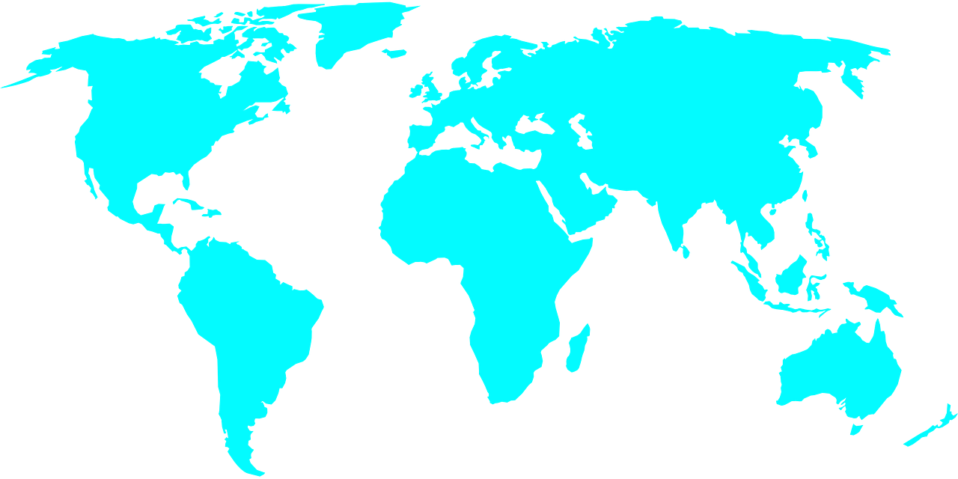
  YEAR 2021
  1 SDA
  to
  every
  82 people
  in IAD
  MEMBRESIA ASD EN RELACIÓN A LA POBLACIÓN
Notes:
This is the current population 301,621,000 / 3,694,454 membership IAD (data of October 2021)

Slide 12
Comparativo de Membresía y Población (2000, 2005, 2010, 2015, 2020)
Percentage | Members | Population
0.53% | 524,207 | 98,196,200
0.53% | 553,925 | 105,266,191
0.60% | 674,755 | 113,285,118
0.59% | 719,005 | 121,112,871
0.61% | 781,863 | 128,257,849

Slide 13
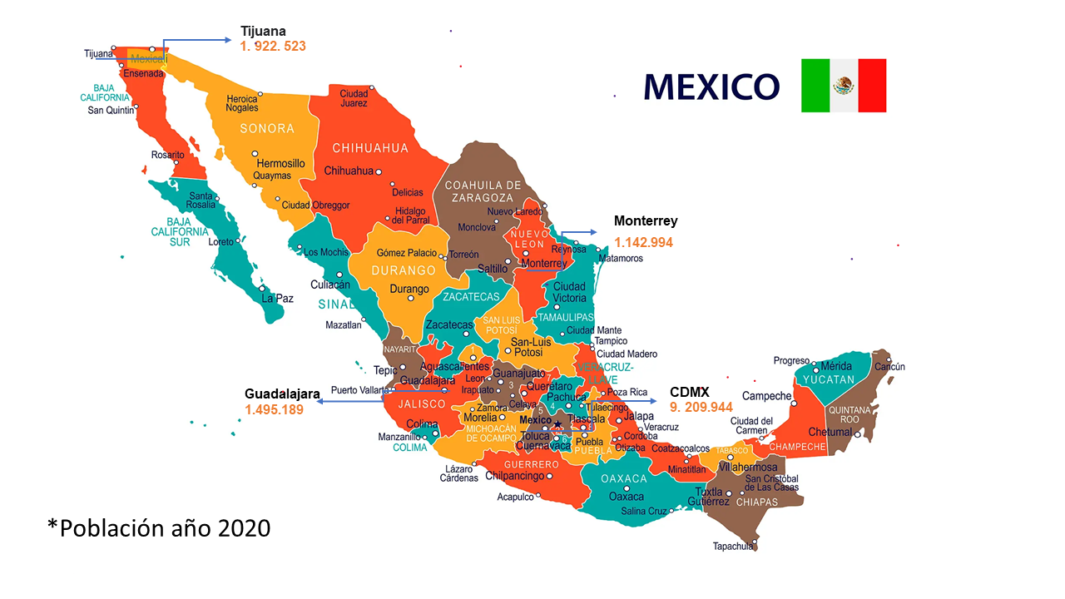

Slide 14
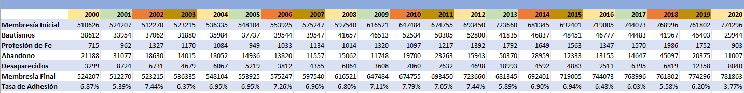
Membresía Total de México

Slide 15
Unión Mexicana del Sureste

Slide 16
Unión Mexicana Central

Slide 17
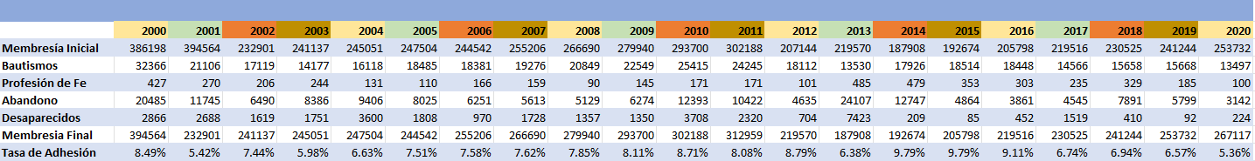
Unión Mexicana de Chiapas

Slide 18
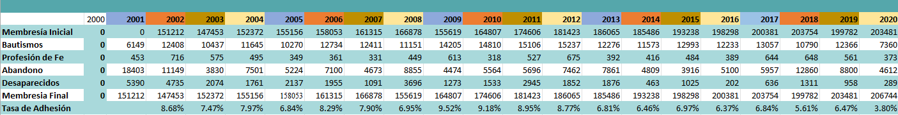
Unión Mexicana Interoceánica

Slide 19
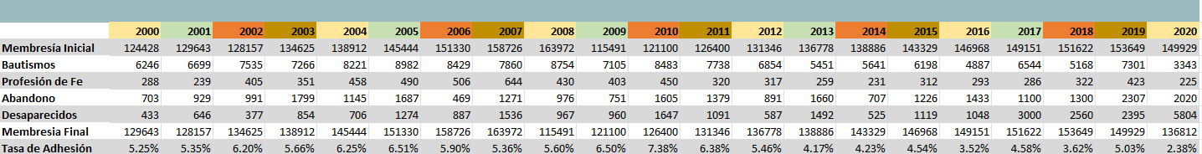
Unión Mexicana del Norte

Slide 20
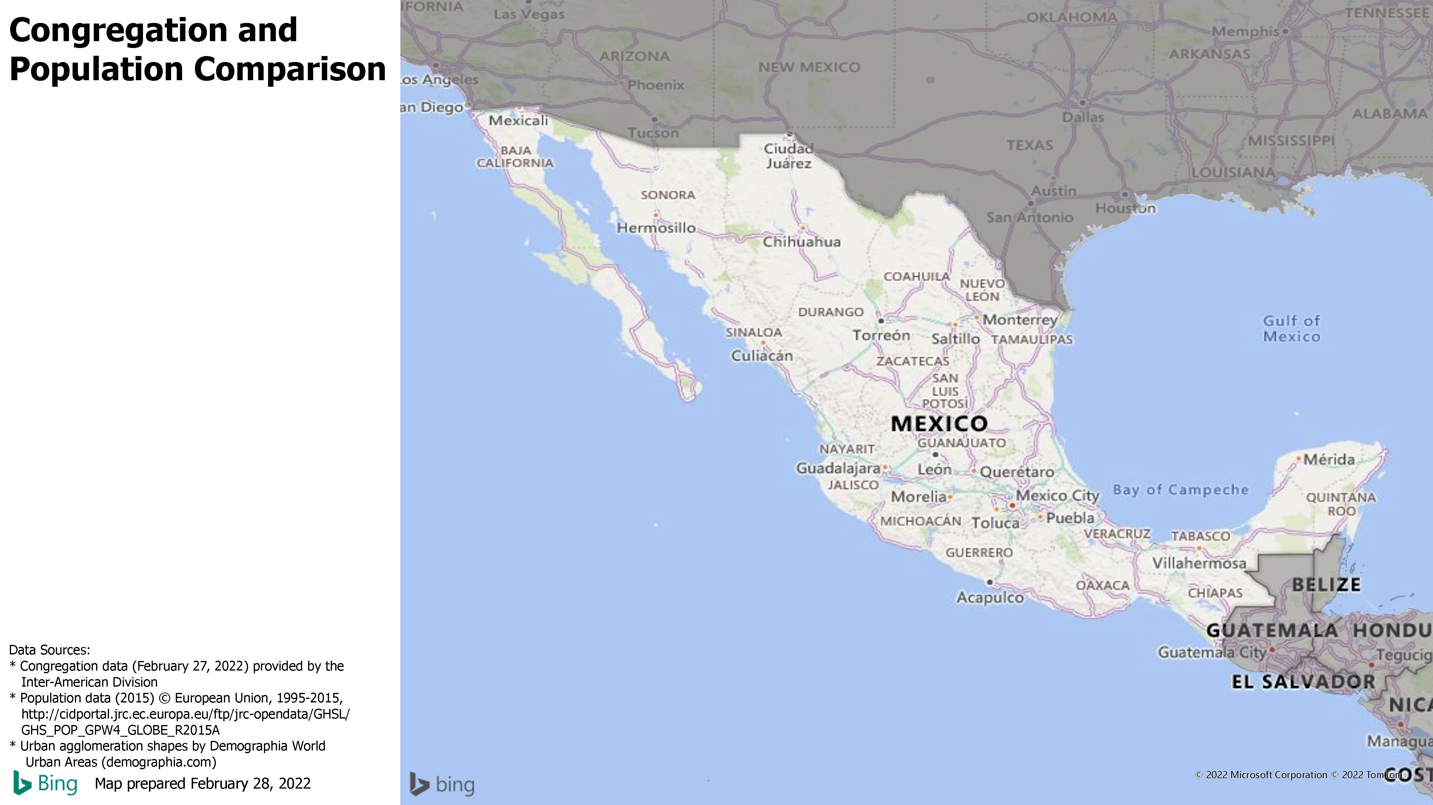

Slide 21
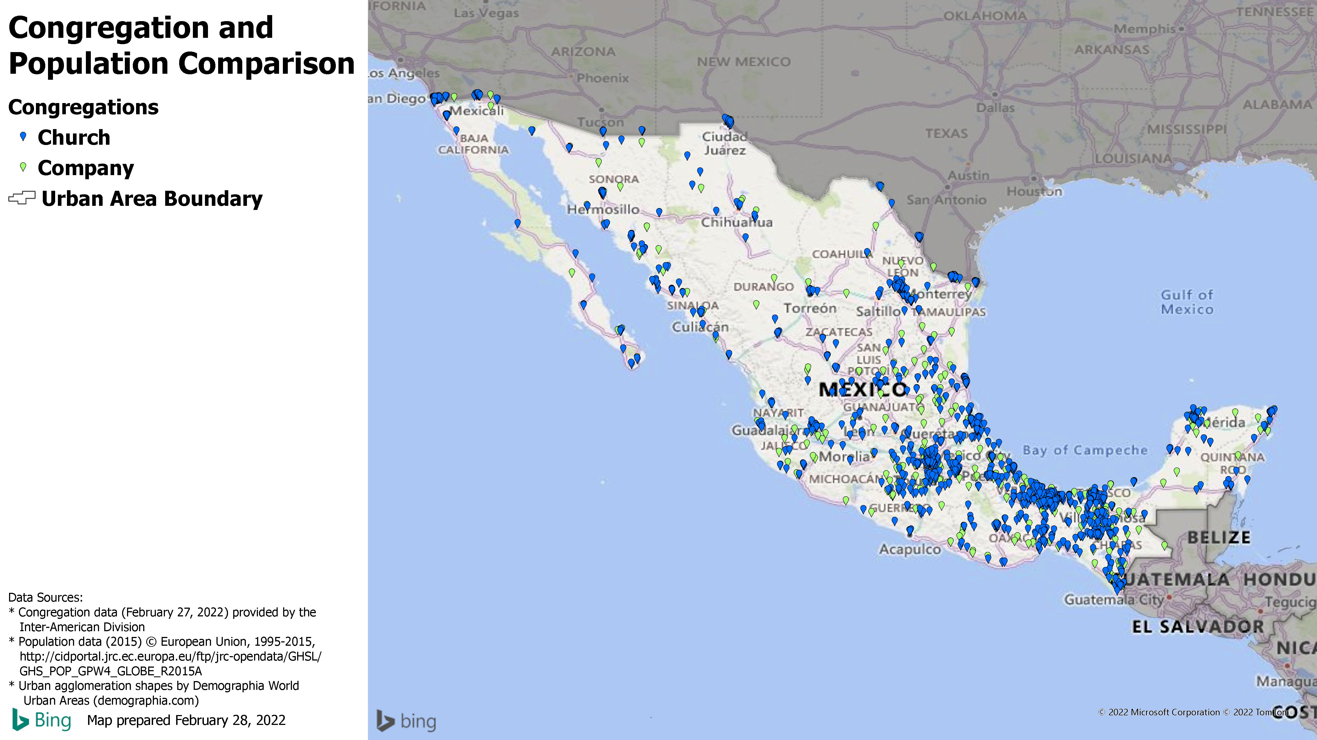

Slide 22
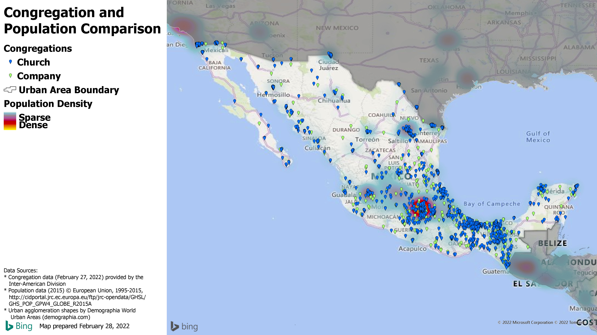

Slide 23
